Slide 1
Brian2GeNN tutorial
Progress – Week 03/12/2021

Slide 2
Content
Introduction
Brian2, GeNN and Brian2GeNN
Practical tutorial Brian2GeNN
Basics: Neurons, connectivity, synapses, monitors, etc
Simulations: Inputs, weights updates, etc
Hands on
Implement LIF neuron with adaptation
Implement a type of STDP and balance inputs of a neuron
Complex models
Example complex synapses
Not supported features Brian2GeNN
Multicompartment neurons

Slide 3
Brian2, GeNN and Brian2Genn

Slide 4
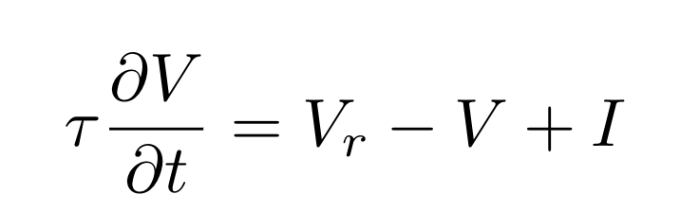
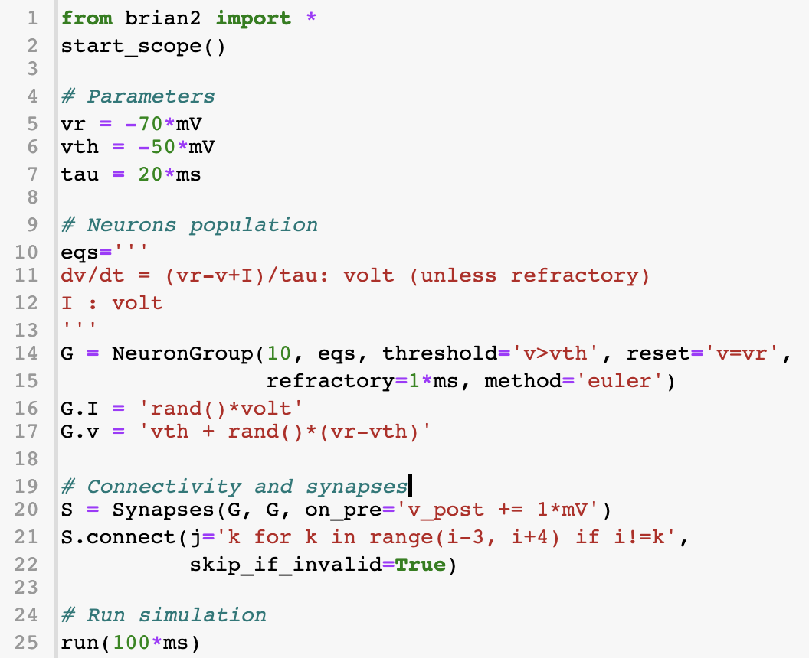
Brian2
Python-based SNN simulator
High level and natural desciptions
C++ code generation from strings
Easy implementation of custom models
High flexibility
Automatic integration of diff. equations
Physical units support
But not mandatory
Events
Only supports CPU execution
Stimberg, M., Brette, R., & Goodman, D. F. (2019). Brian 2, an intuitive and efficient neural simulator. Elife, 8, e47314.

Slide 5
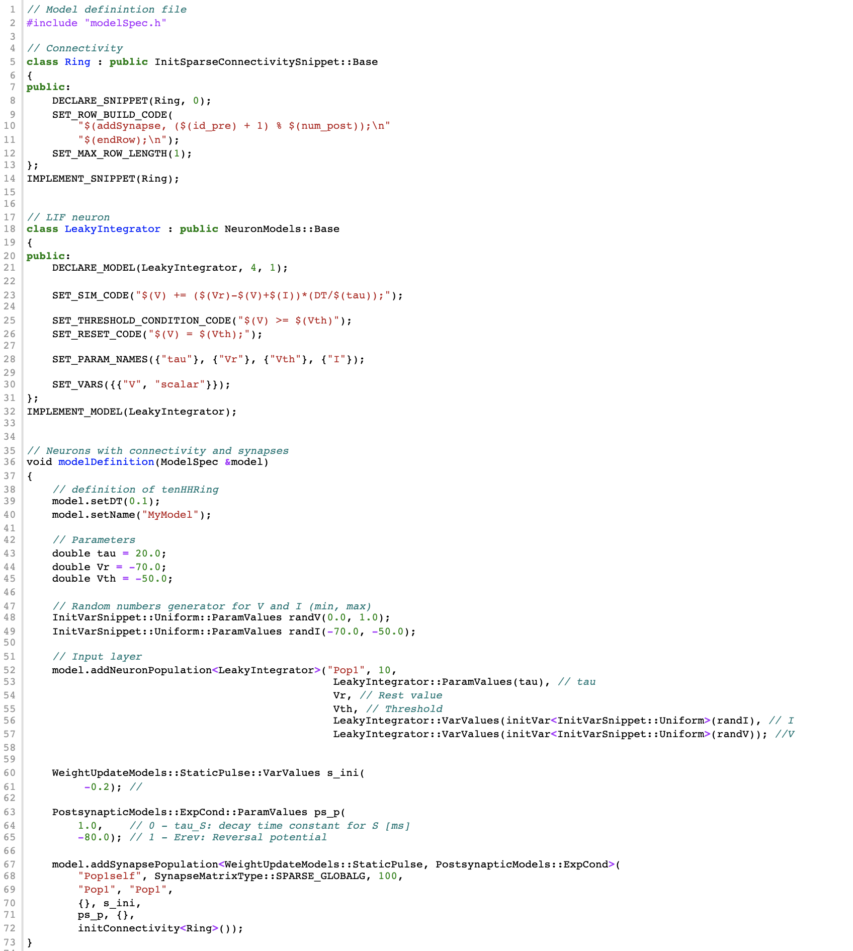
GeNN
C++-based SNN simulator
Object oriented descriptions
CUDA code generated from them
Many implemented models
Custom models as extensions of existing templates
Plug them in the simulation
Hard to debug
Supports GPU execution
Yavuz, E., Turner, J., & Nowotny, T. (2016). GeNN: a code generation framework for accelerated brain simulations. Scientific reports, 6(1), 1-14.

Slide 6
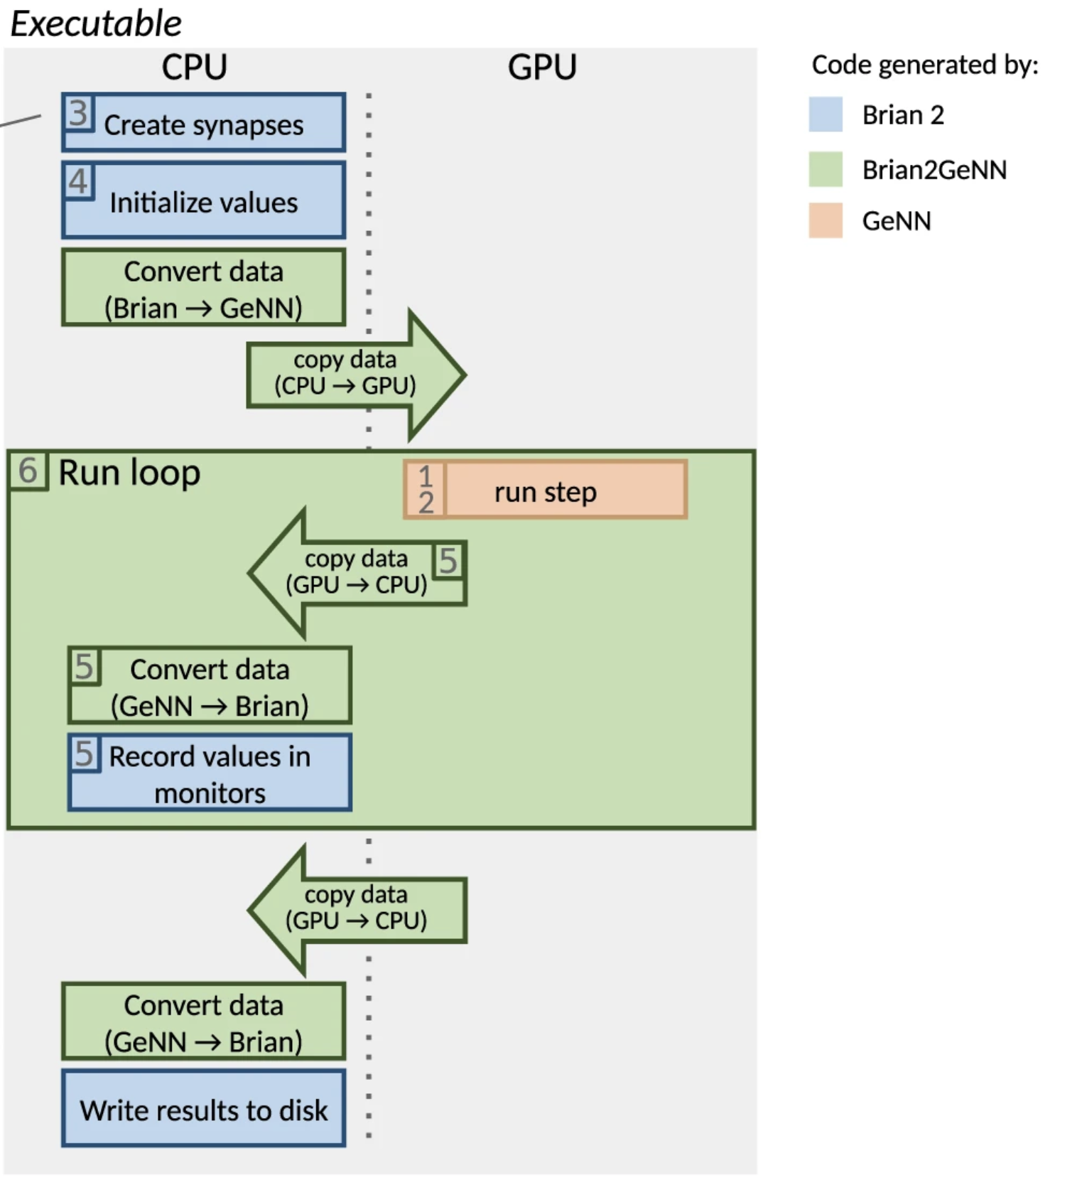
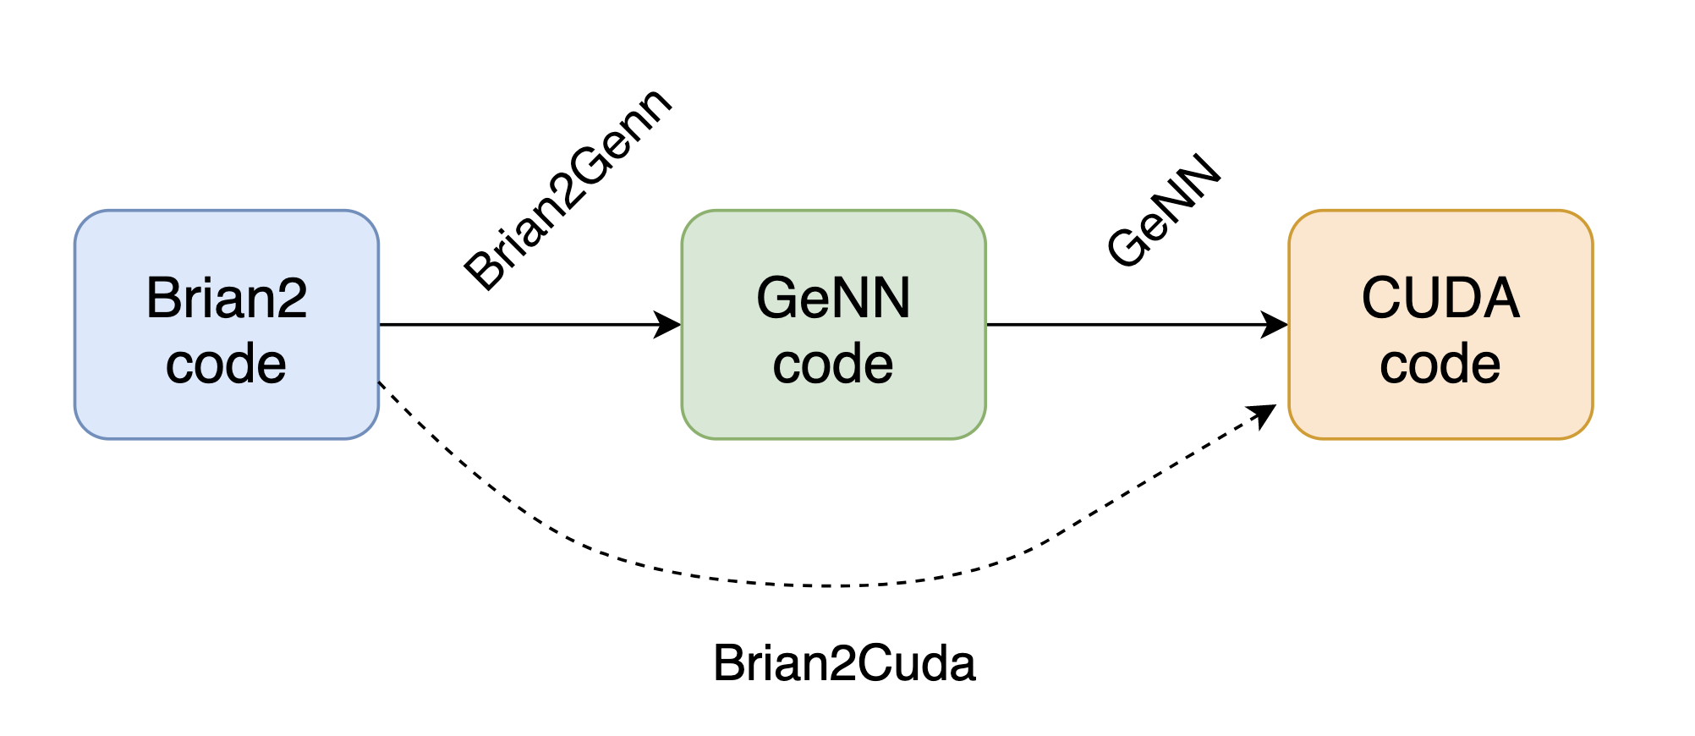
Brian2GeNN
Brian interface with GPU support
Translates Brian code into GeNN code
Stimberg, M., Goodman, D. F., & Nowotny, T. (2020). Brian2GeNN: accelerating spiking neural
network simulations with graphics hardware. Scientific reports, 10(1), 1-12.

Slide 7
Practical tutorial Brian2GeNN

Slide 8
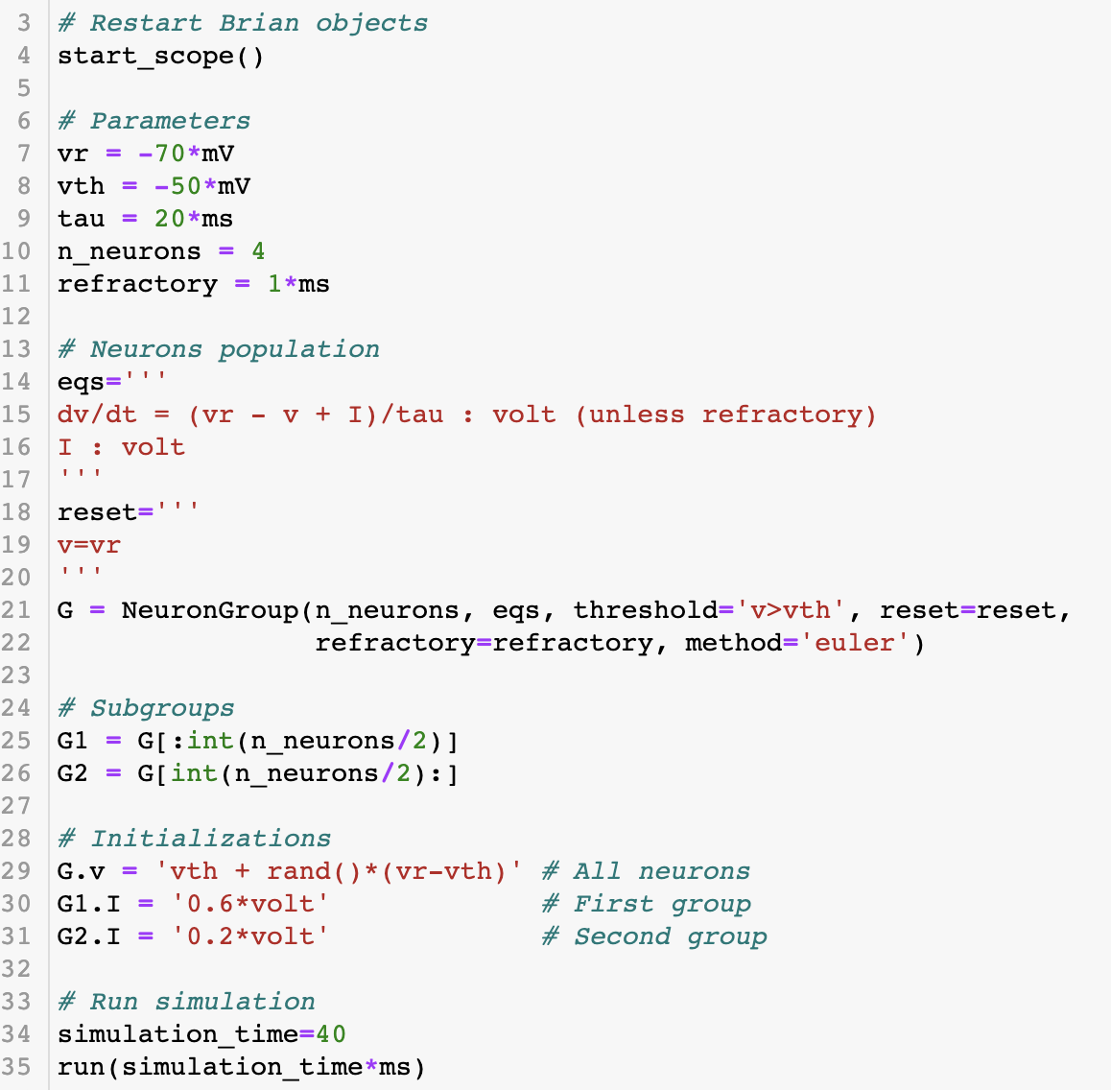
Basics - Neurons
Equations
Threshold
Reset
Refractoriness
Integration
Subgroups
https://brian2.readthedocs.io/en/stable/user/models.html#id10

Slide 9
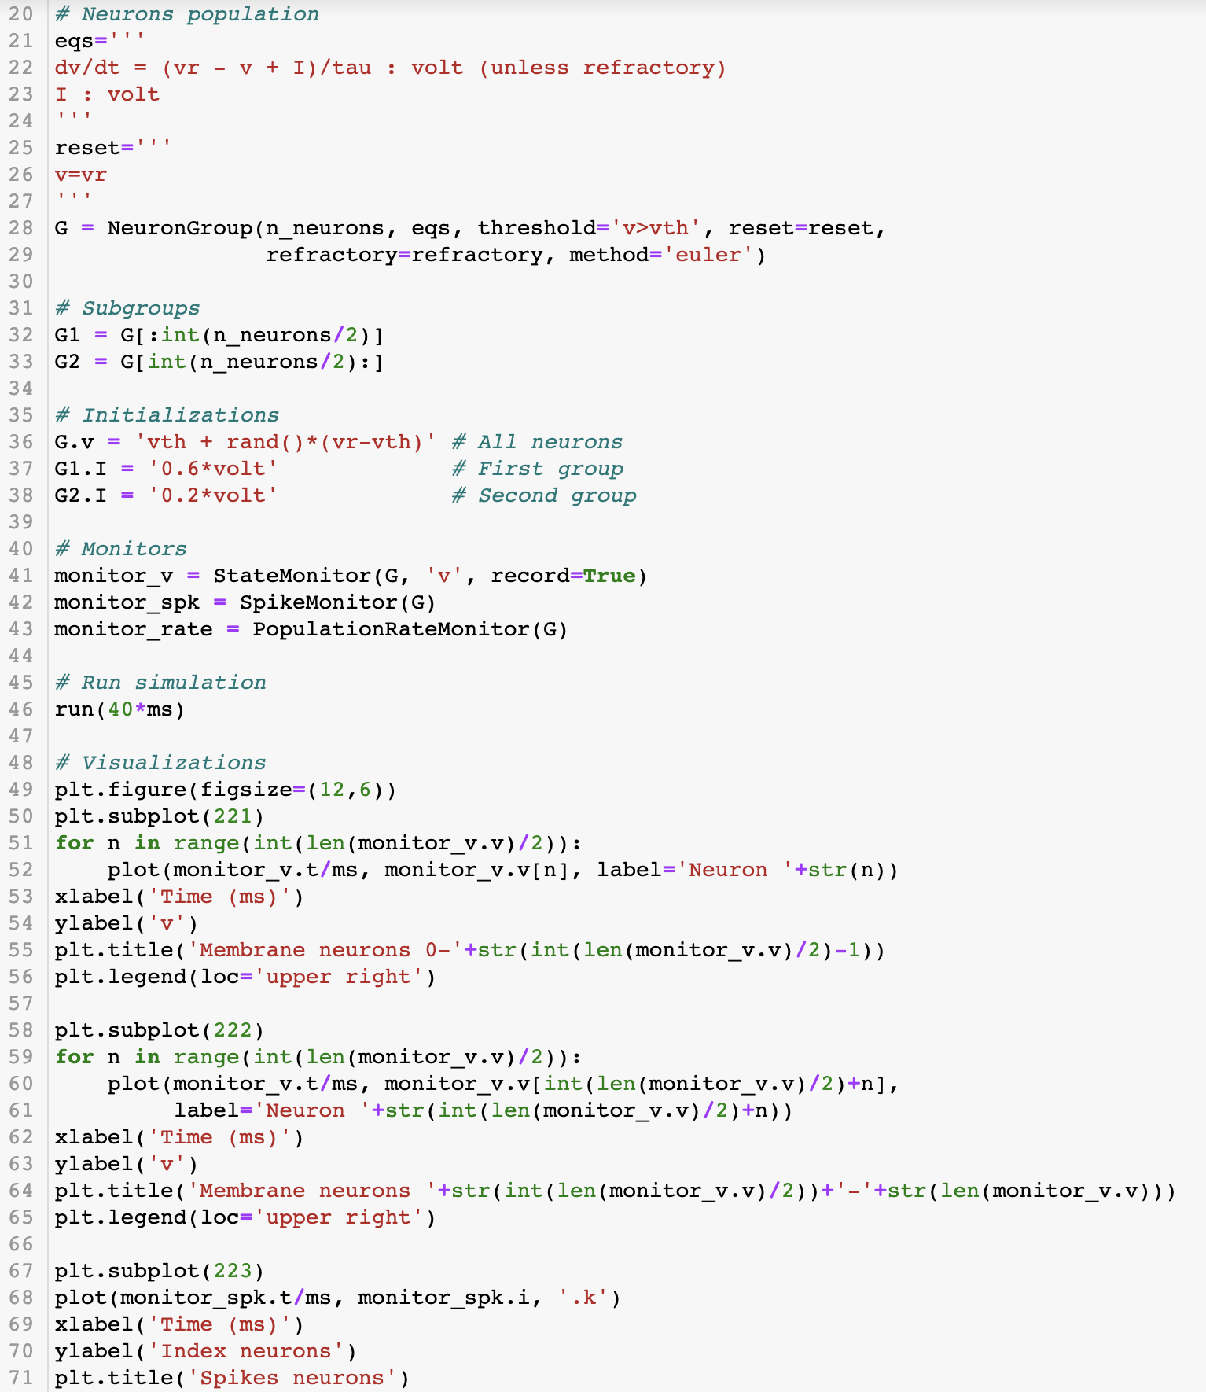
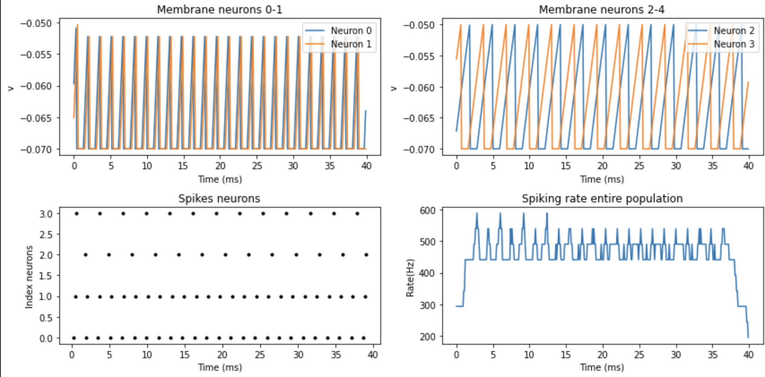
Basics - Monitors
Record variables
Record spikes
Record spiking rate
https://brian2.readthedocs.io/en/stable/user/recording.html

Slide 10
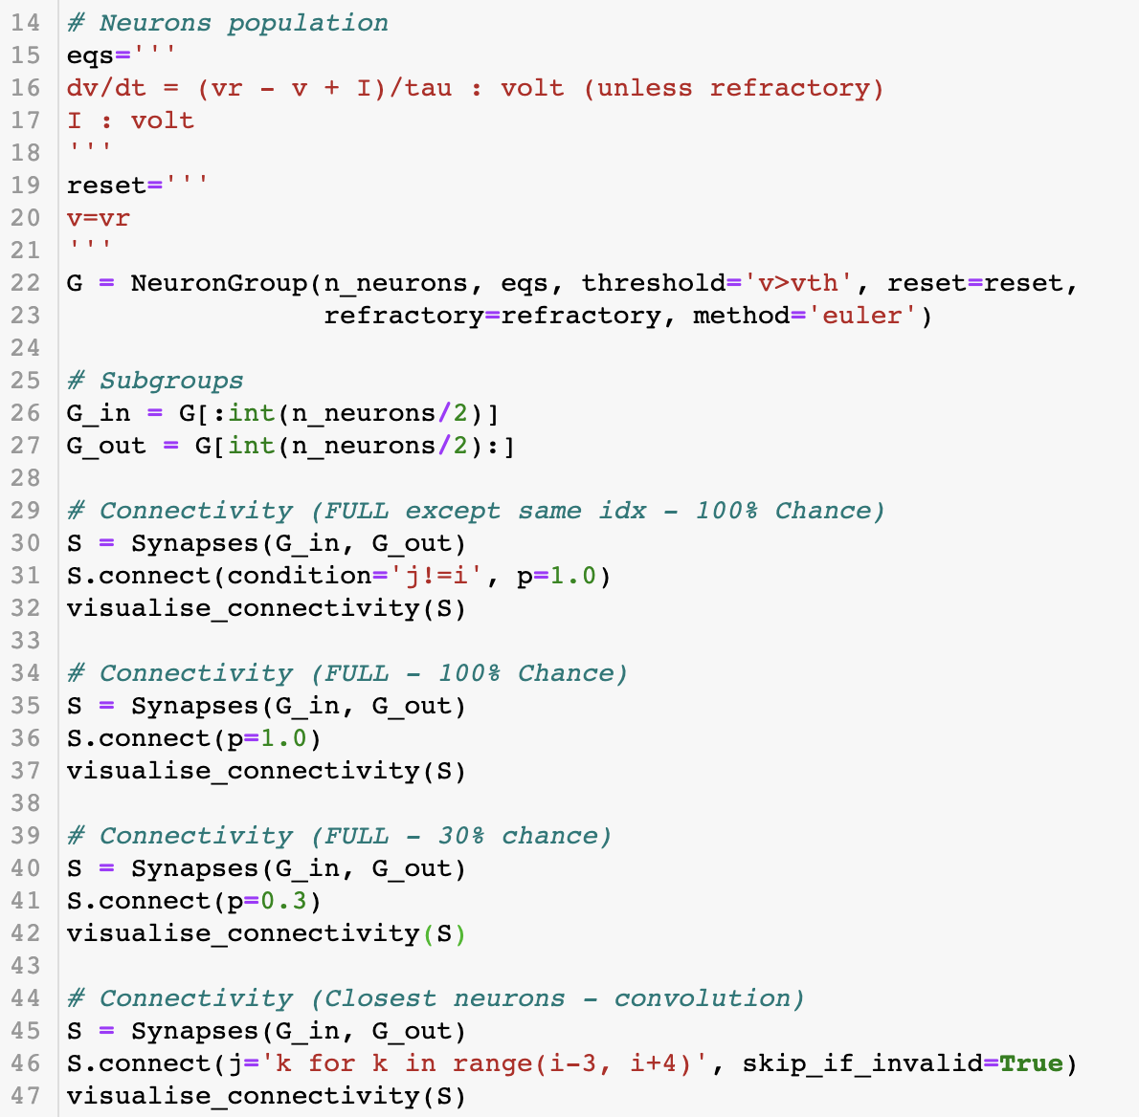
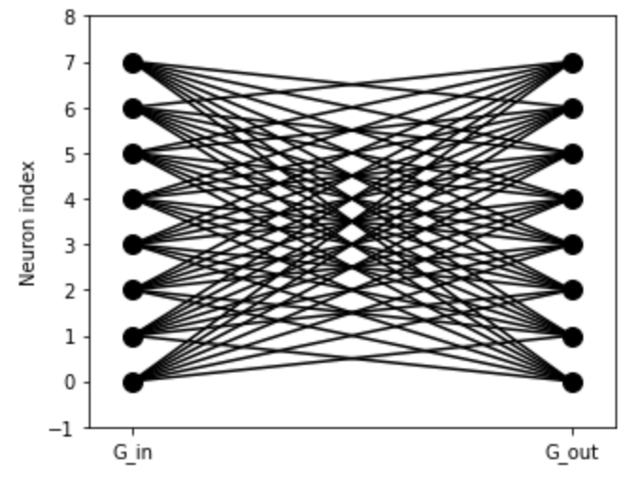
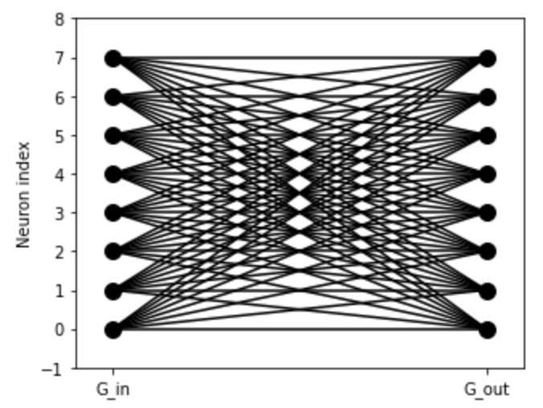
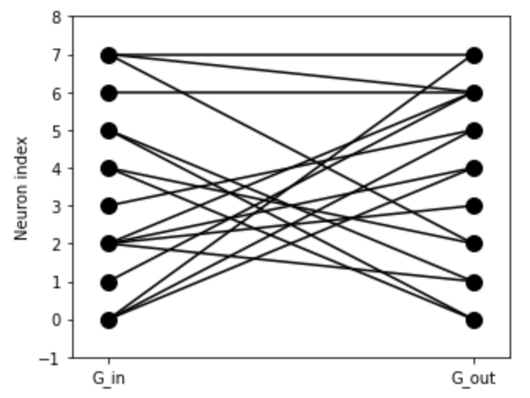
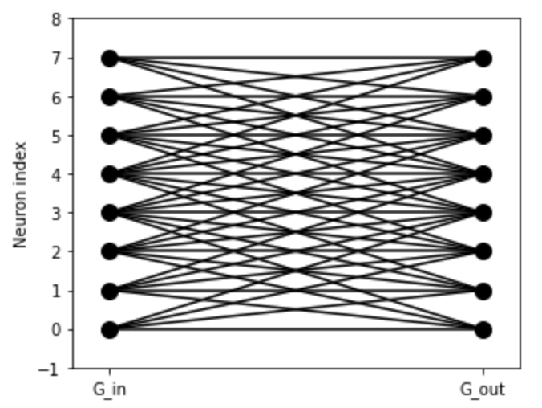
Basics - Synapses
Connectivity
1
2
1
2
3
4
3
4
https://brian2.readthedocs.io/en/stable/user/synapses.html#synaptic-connection-weight-matrices

Slide 11
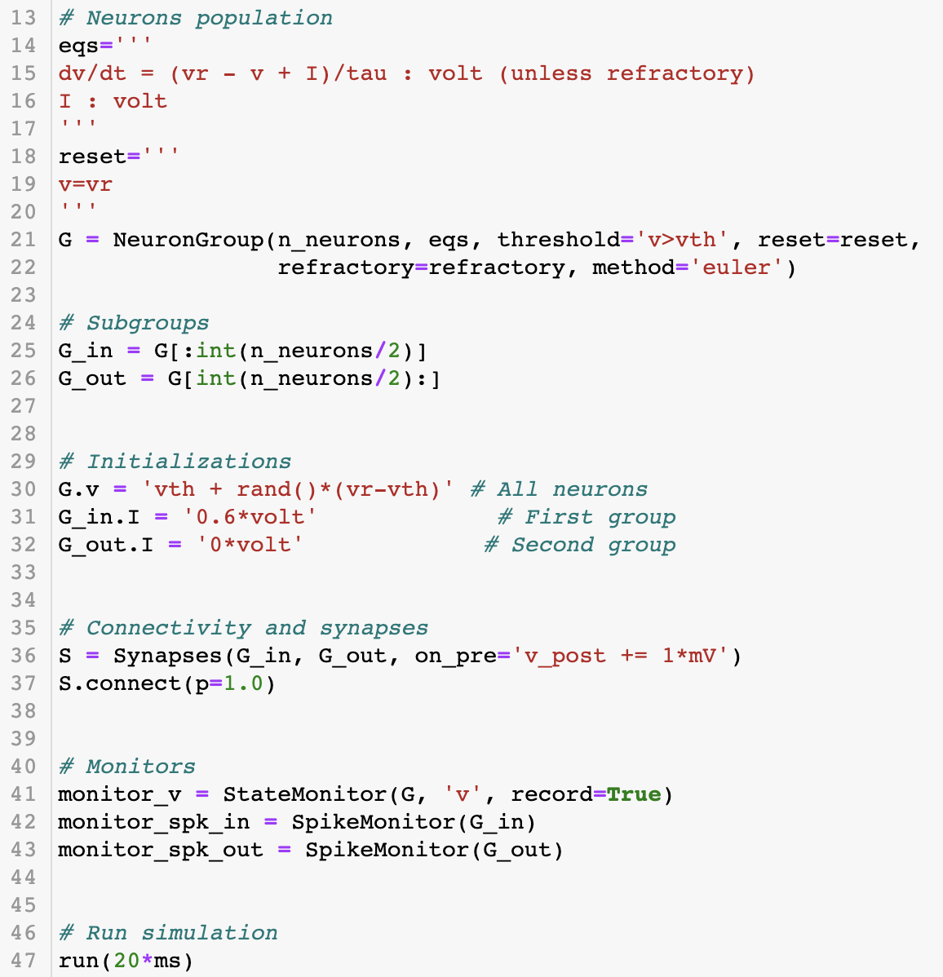
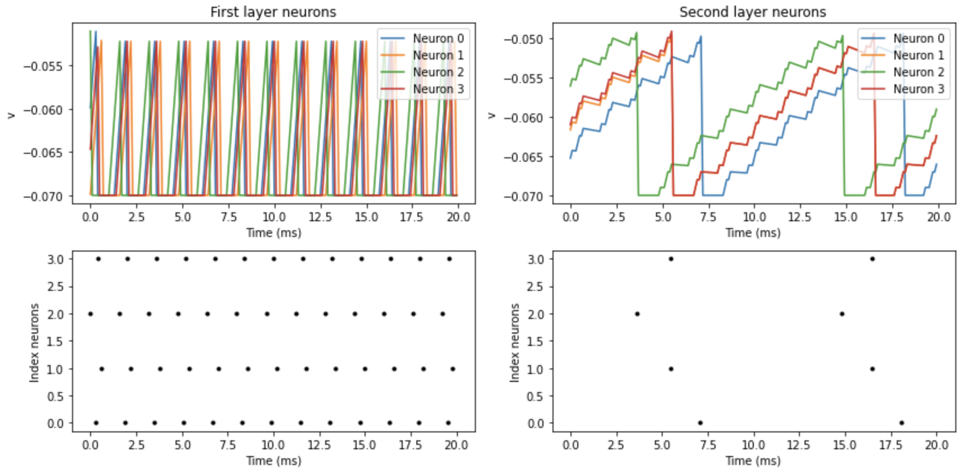
Basics - Synapses
Post spike effect
Current injection (Increase v or I)
https://brian2.readthedocs.io/en/stable/user/synapses.html#

Slide 12
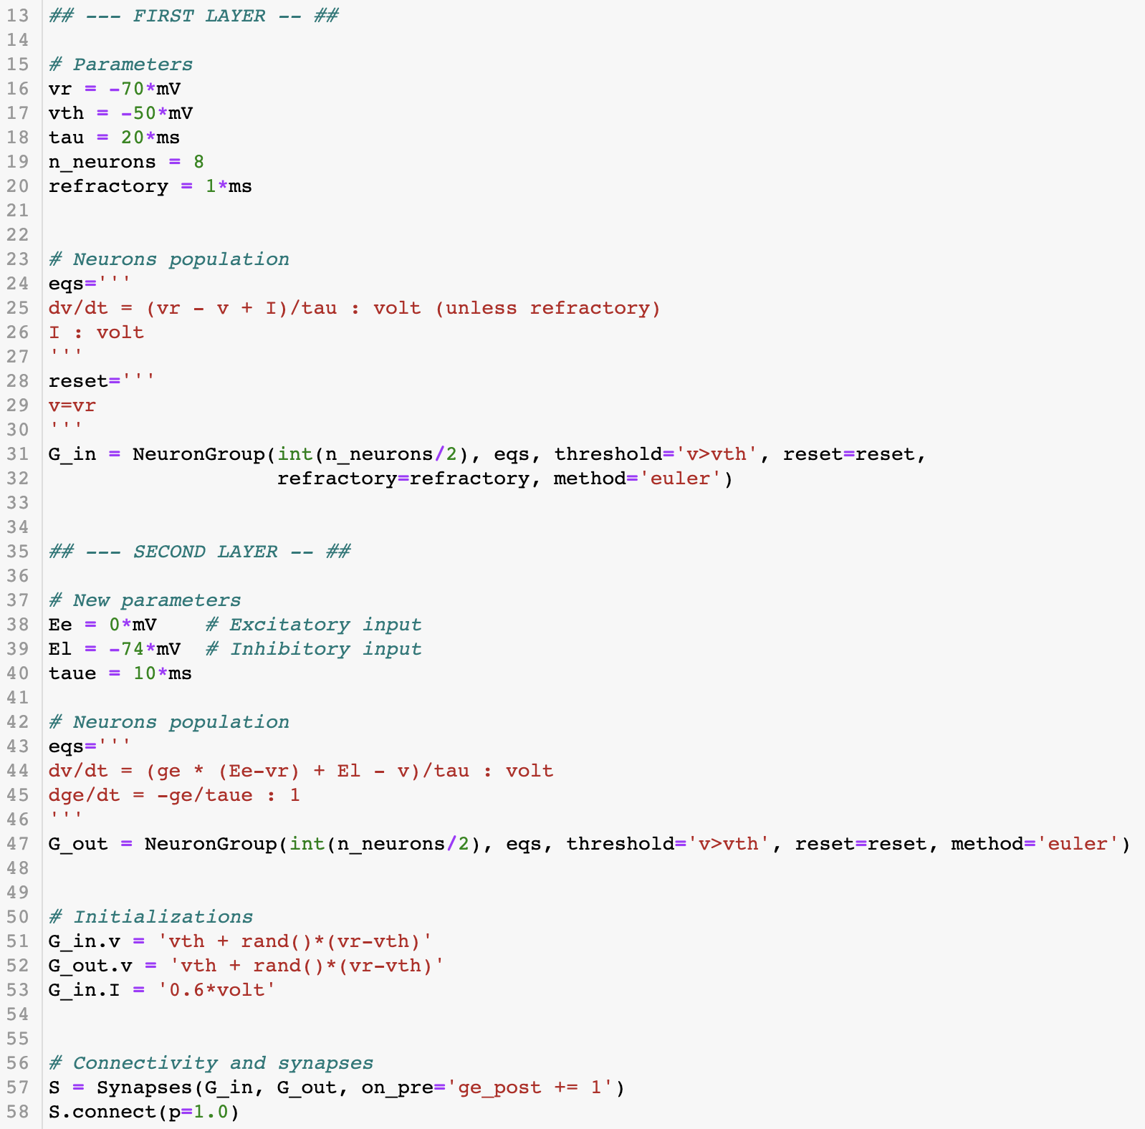
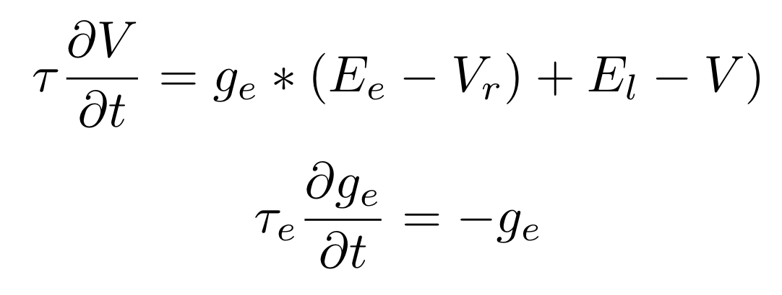
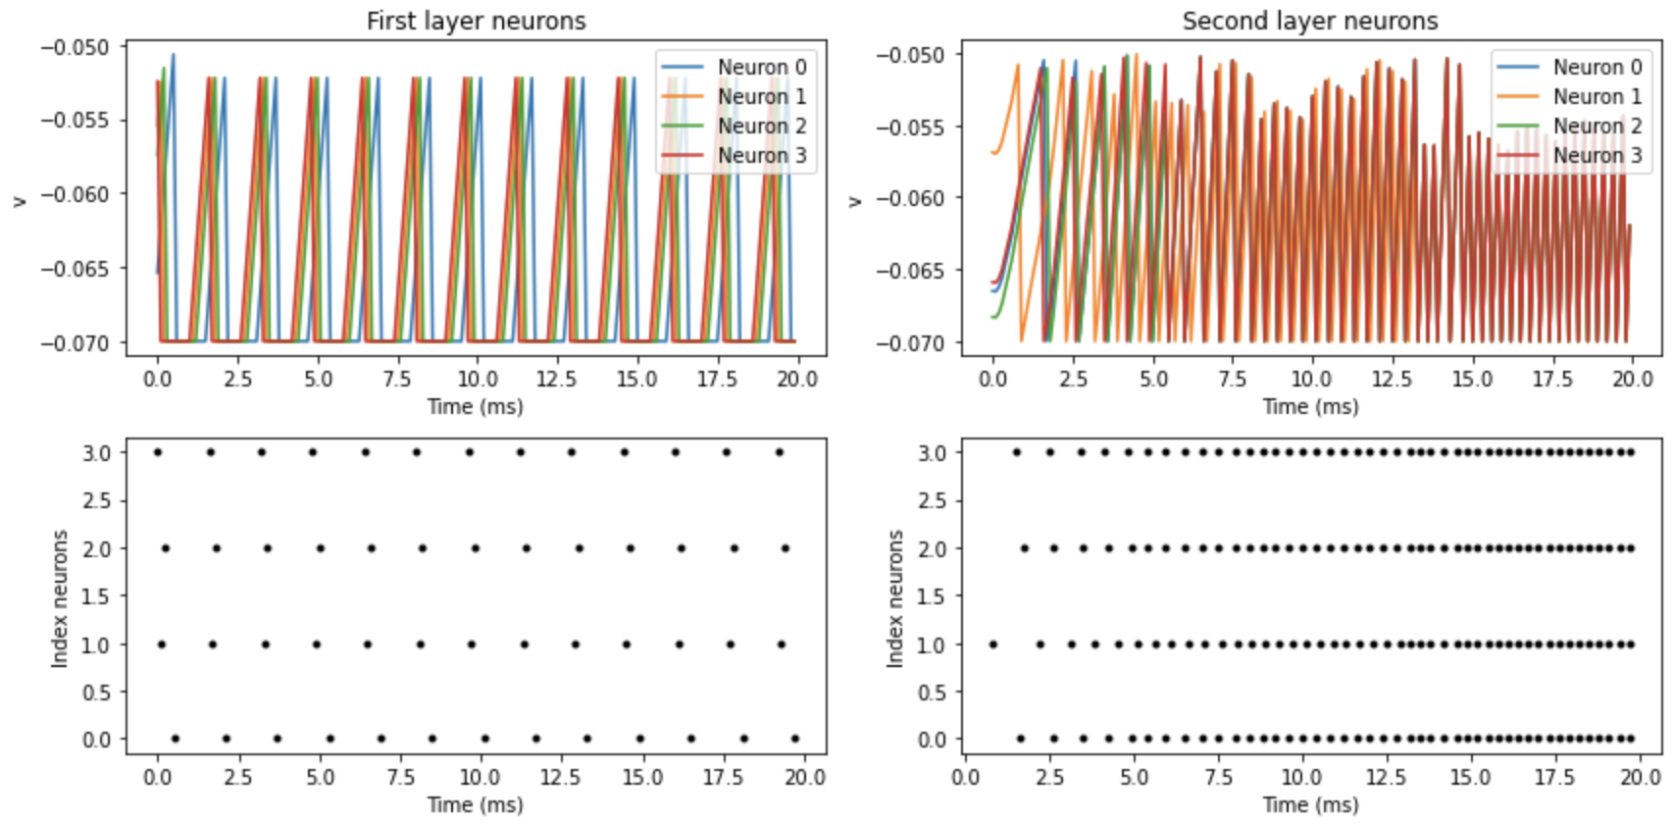
Basics - Synapses
Post spike effect
Conductance (more complex neuron models)
https://brian2.readthedocs.io/en/stable/user/synapses.html#

Slide 13
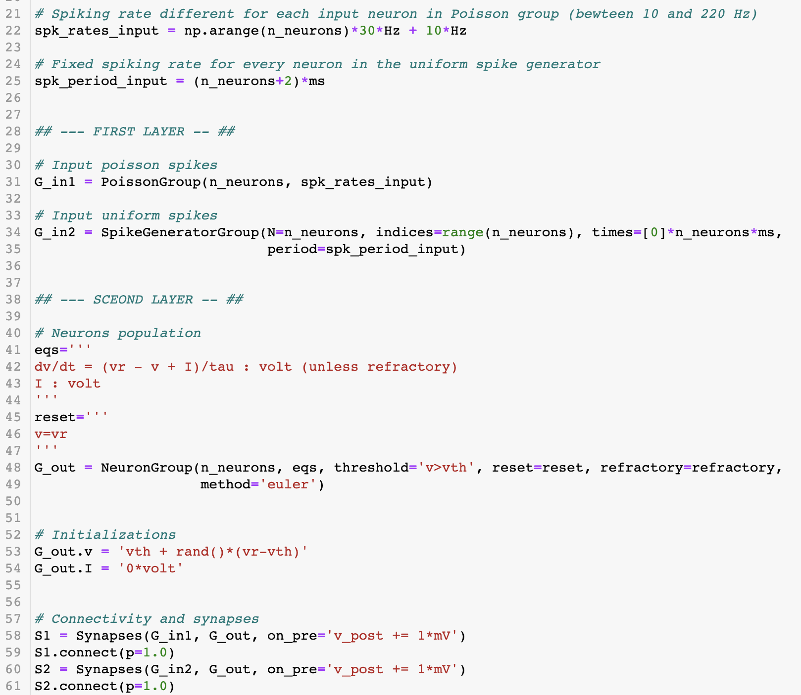
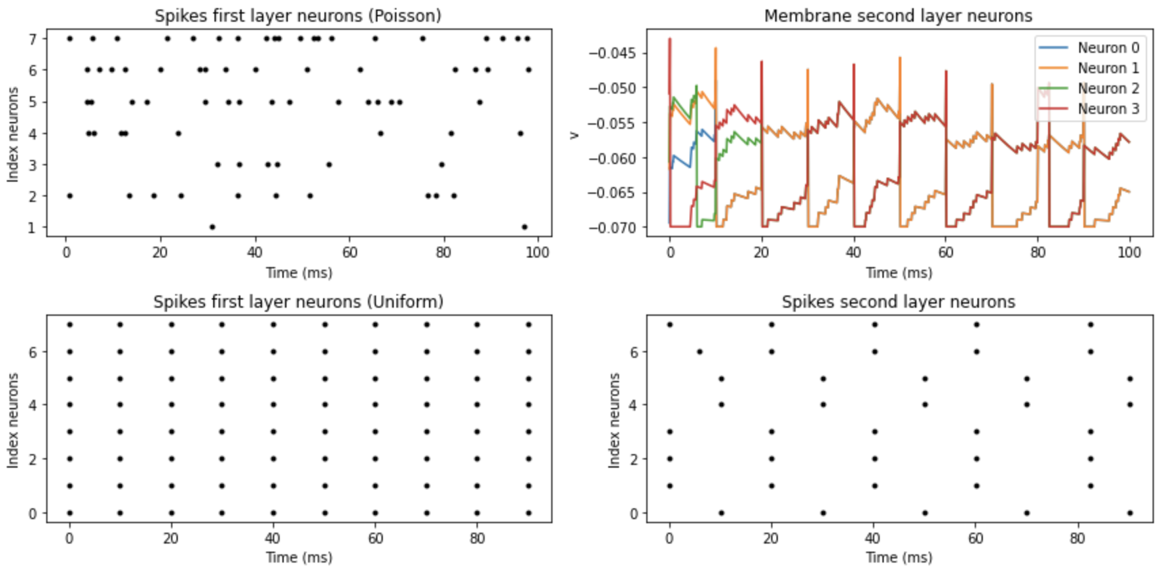
Simulations - Neurons input
Input current
Input spikes
PoissonGroup
SpikesGenerator
https://brian2.readthedocs.io/en/stable/user/input.html

Slide 14
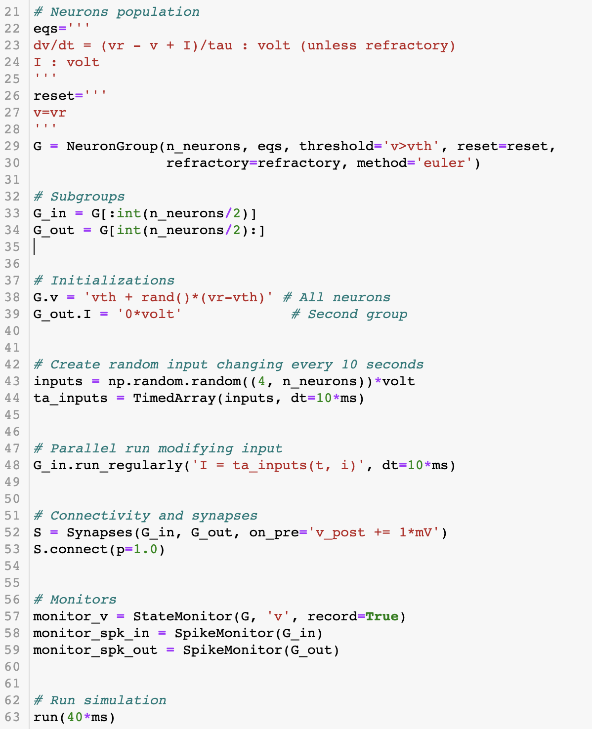
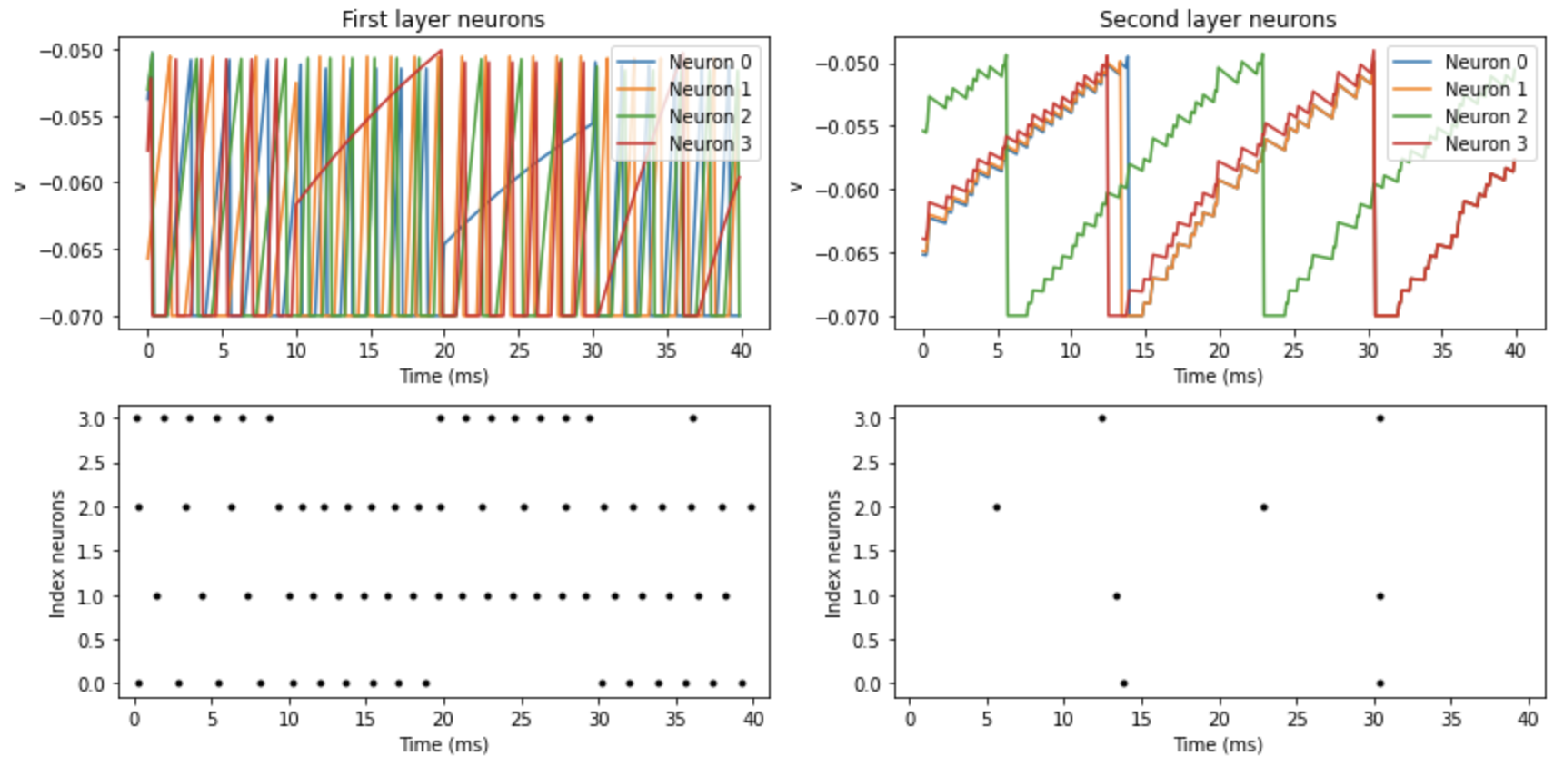
Simulations - Neurons input
Non-static input
Time array
Run regularly
When
using only
Brian
https://brian2.readthedocs.io/en/stable/user/input.html

Slide 15
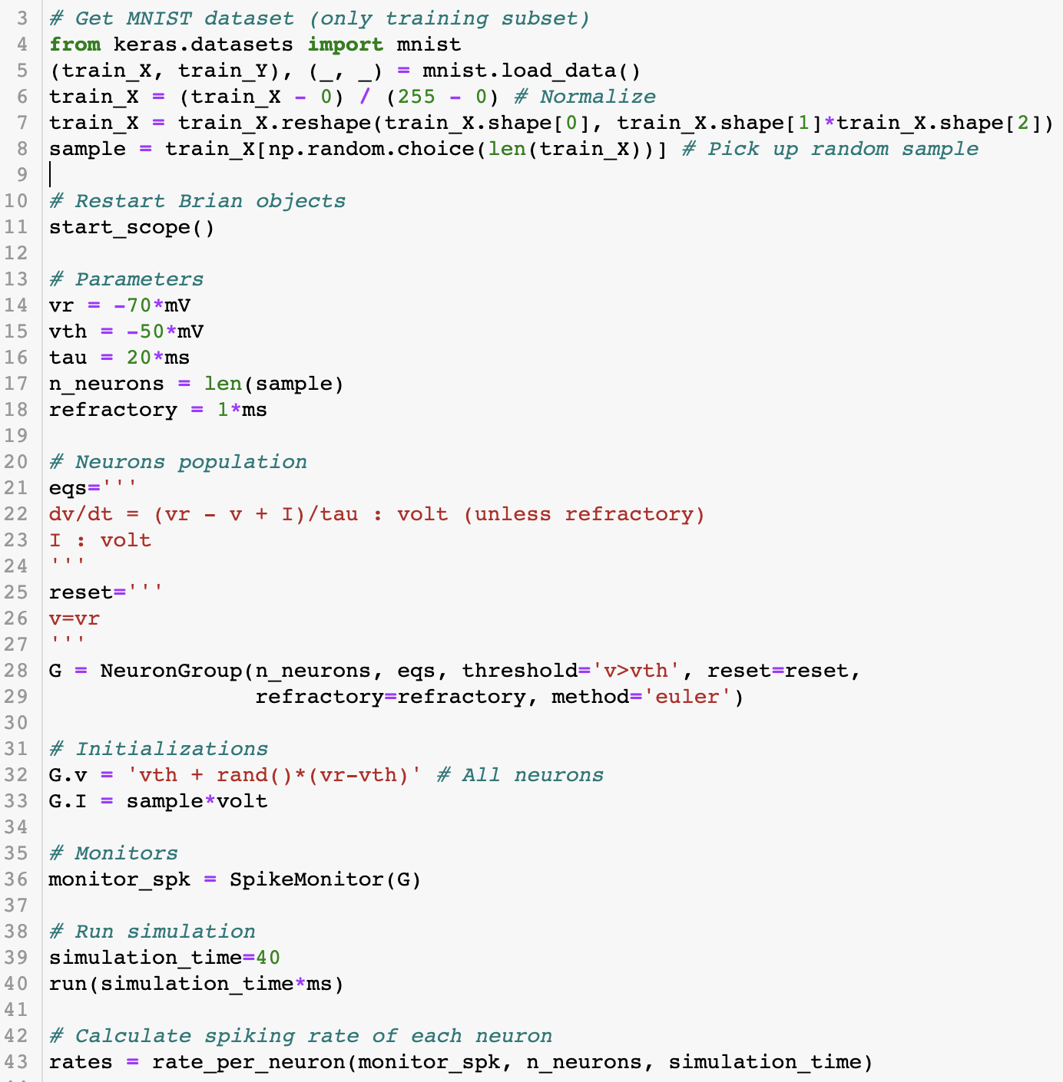
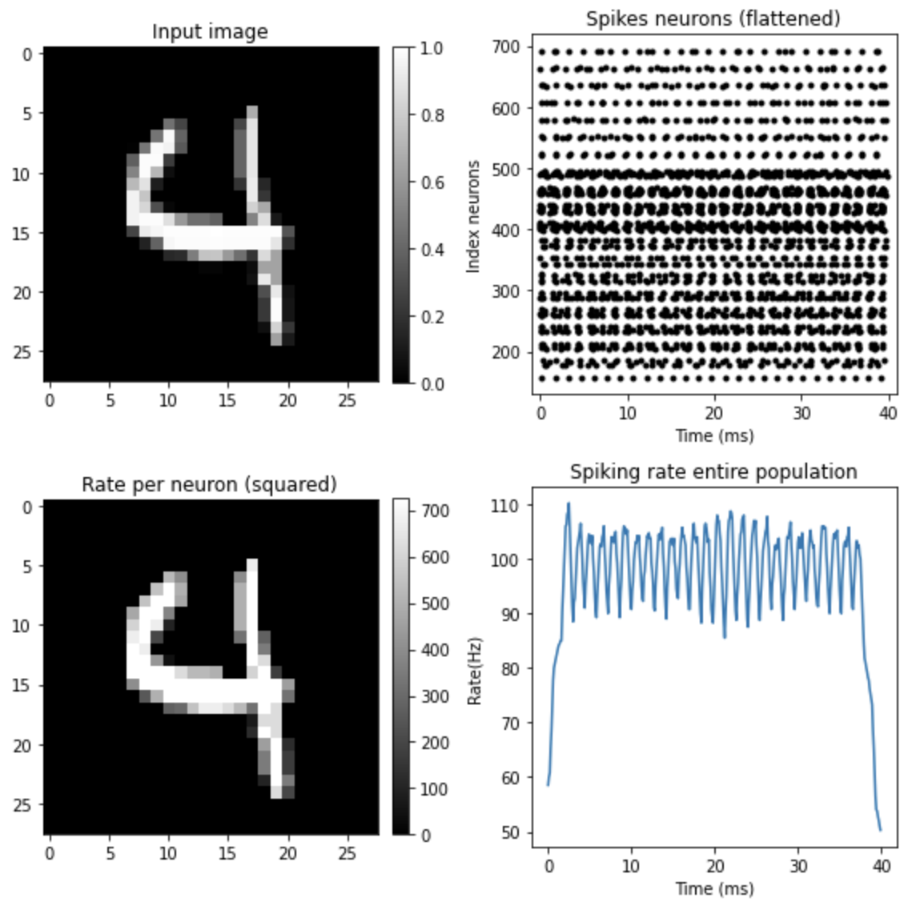
Simulations - Neurons input
Using datasets
Example: MNIST
One neuron per input value
Input values as input currents or as spikes trains (value= spiking rate)
https://brian2.readthedocs.io/en/stable/user/input.html

Slide 16
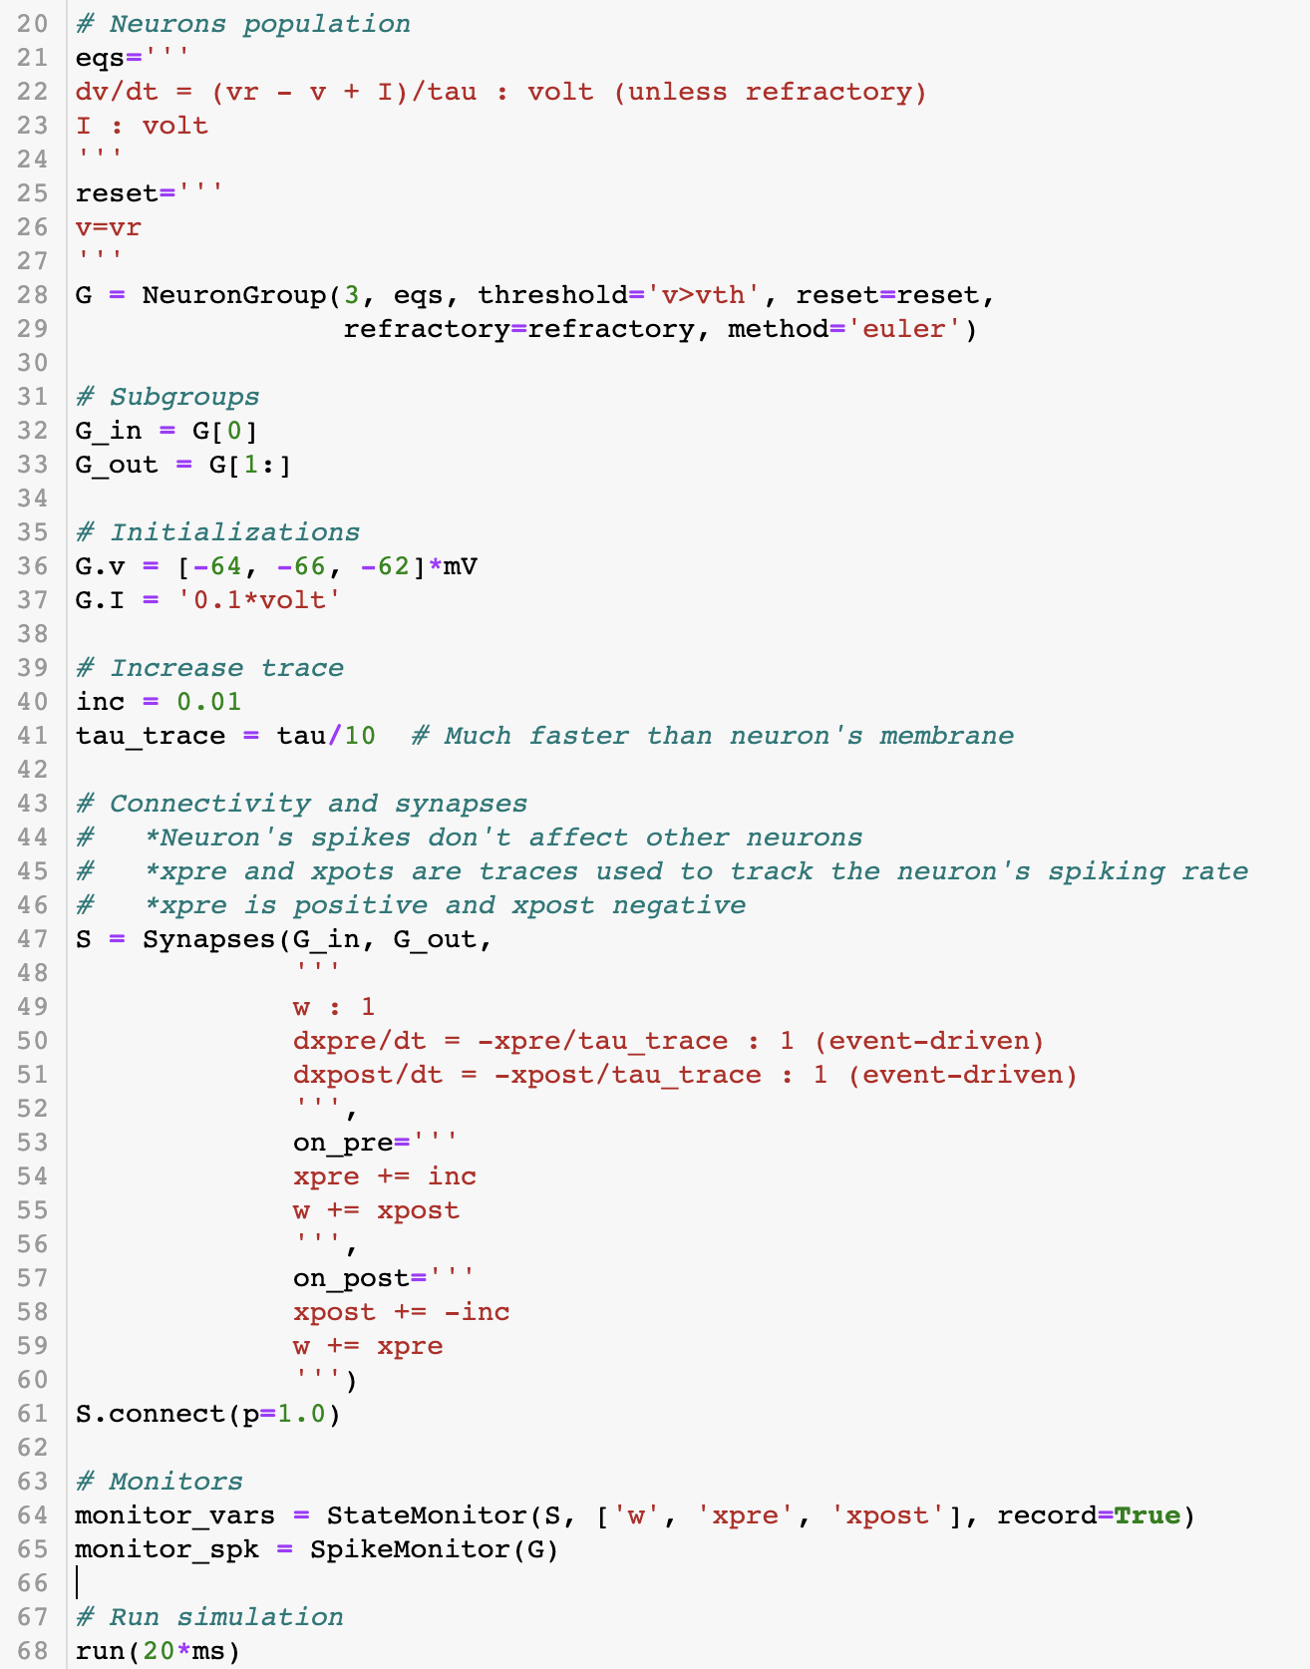
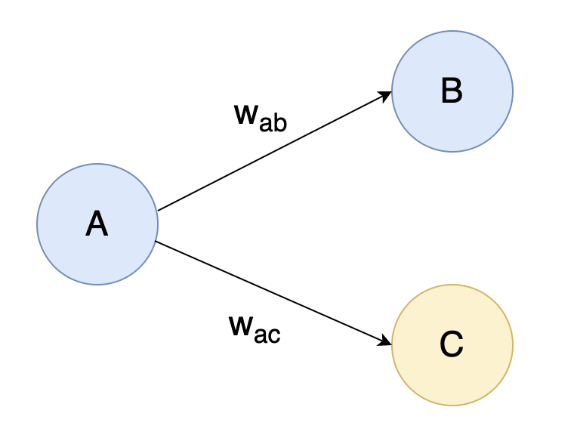
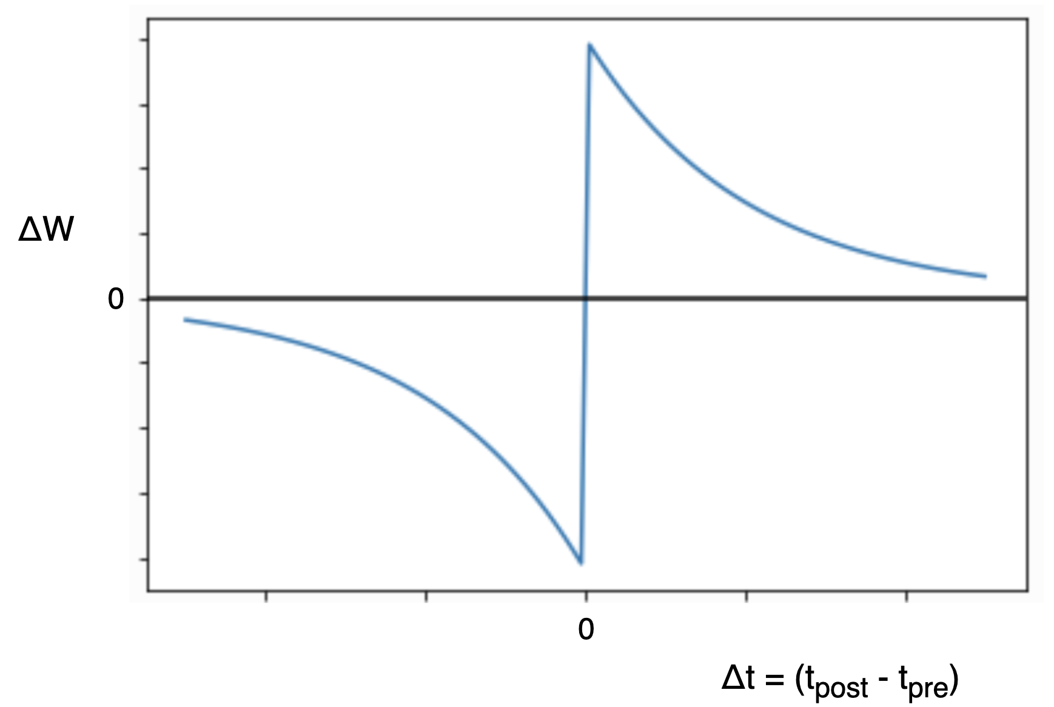
Simulations - Weights updates
Learning at spike times
“on_pre” and “on_post”
Equations can be simulated in synapses (e.g. traces spiking rate)
Example:
Simple STDP with 3 neurons
Neuron B spikes right after A and neuron C spikes right before A
http://www.scholarpedia.org/article/Spike-timing_dependent_plasticity

Slide 17
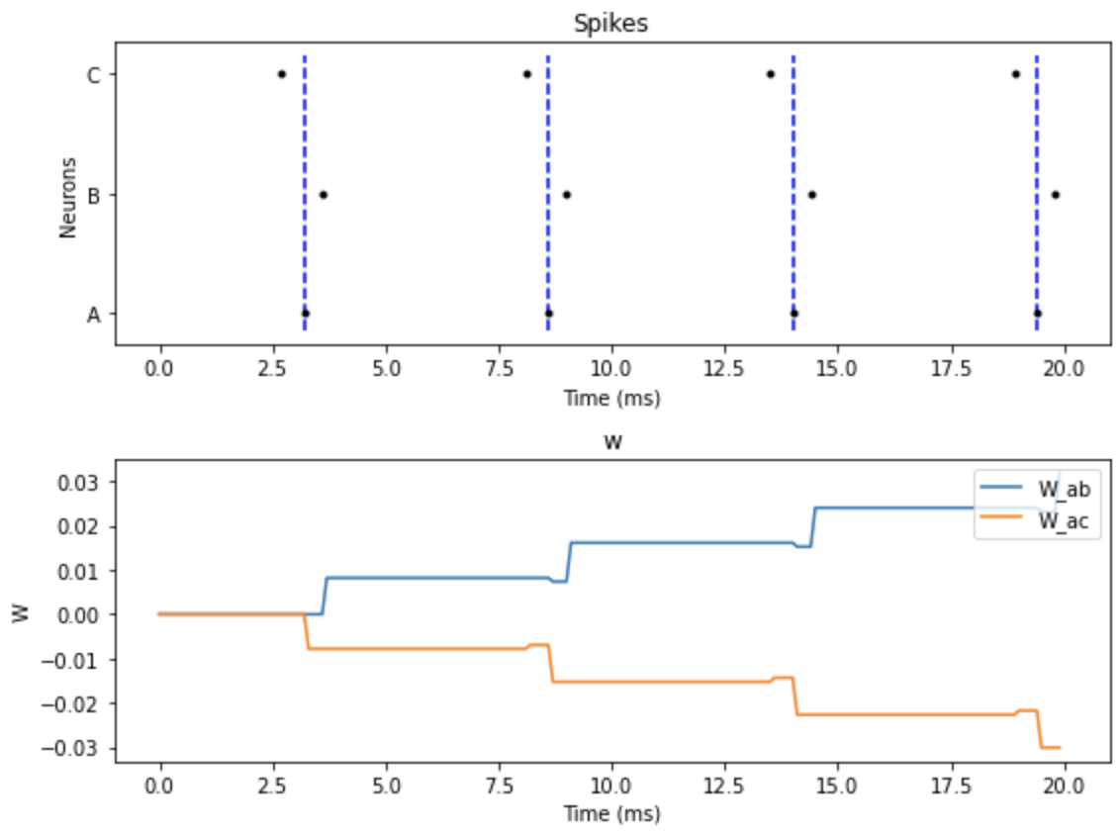
Simulations - Weights updates
STDP
http://www.scholarpedia.org/article/Spike-timing_dependent_plasticity

Slide 18
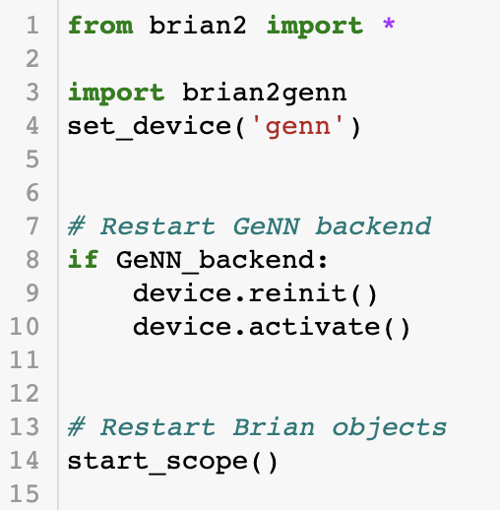
Basics - GeNN backend
Install GeNN and Brian2GeNN beforehand
Configure some paths
Add just a few lines
Program compiled on the run
It adds compilation time
Worth it only in large simulations
https://brian2genn.readthedocs.io/en/stable/introduction/index.html

Slide 19
Hands on

Slide 20
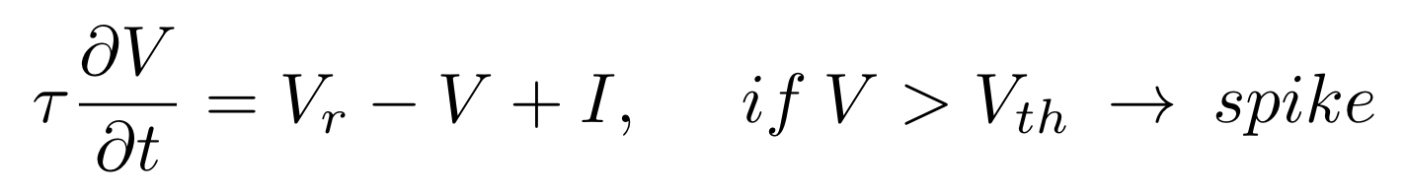
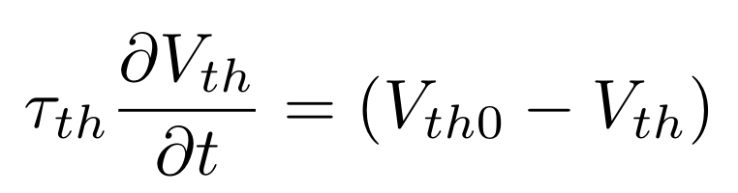
Leaky Integrate and Fire with adaptation
Execute previous noteboks
Explore different parameters and see how they affect the simulation
Implement a Leaky Integrate and Fire neuron with adaptive threshold
Dynamics LIF →
Dynamics threshold →
V_{th} tends to a V_{th0}
τ_{th} is much faster than τ
V_{th} increases in every spike
Link to notebook: https://colab.research.google.com/drive/11BDgUn_zkbtLn7uw_isz4i1Ro_5nbf3O?usp=sharing
https://github.com/jesusgf96/Brian2GeNN_introduction/blob/main/Brian2GeNN_tutorial.ipynb

Slide 21
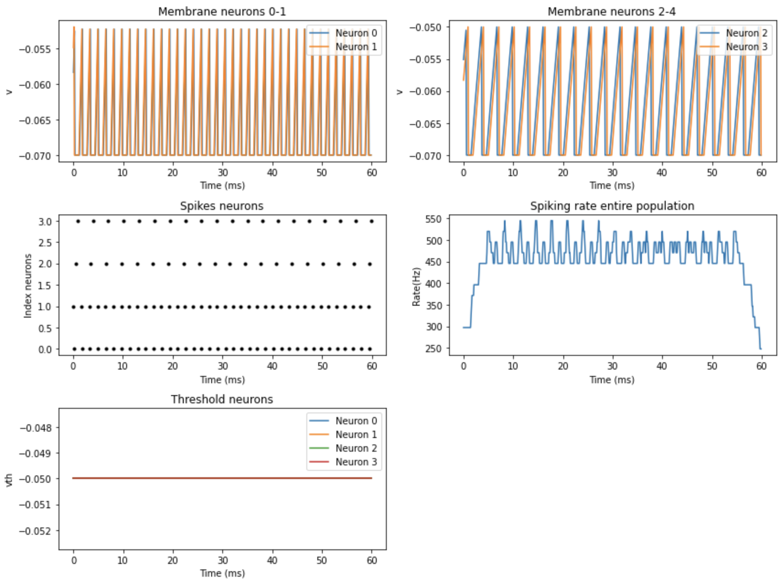
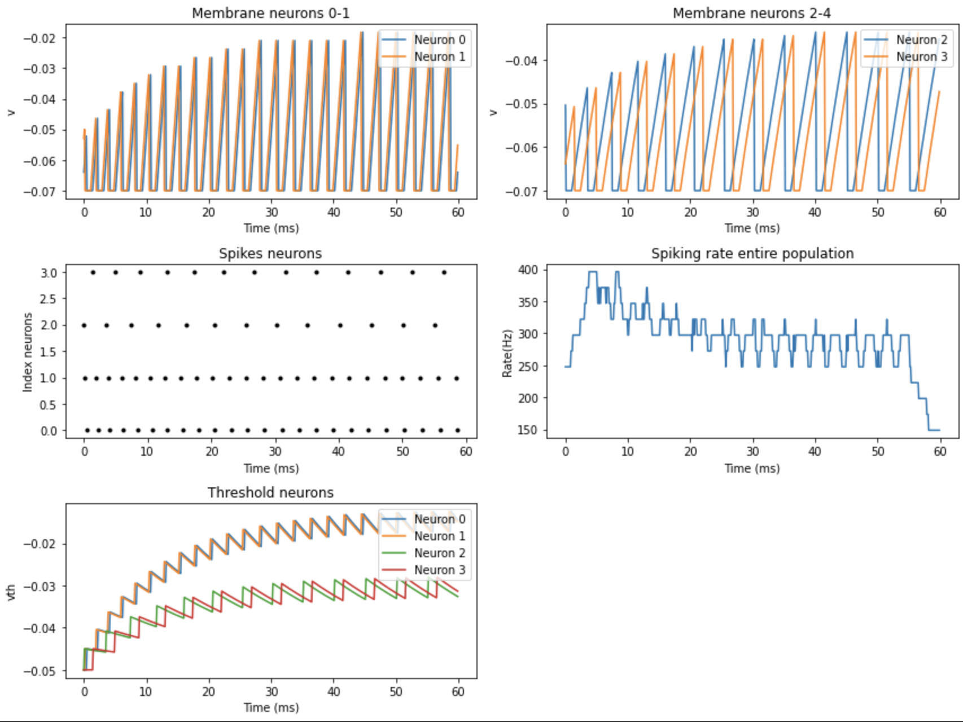
Leaky Integrate and Fire with adaptation
Fixed threshold
Adaptive threshold

Slide 22
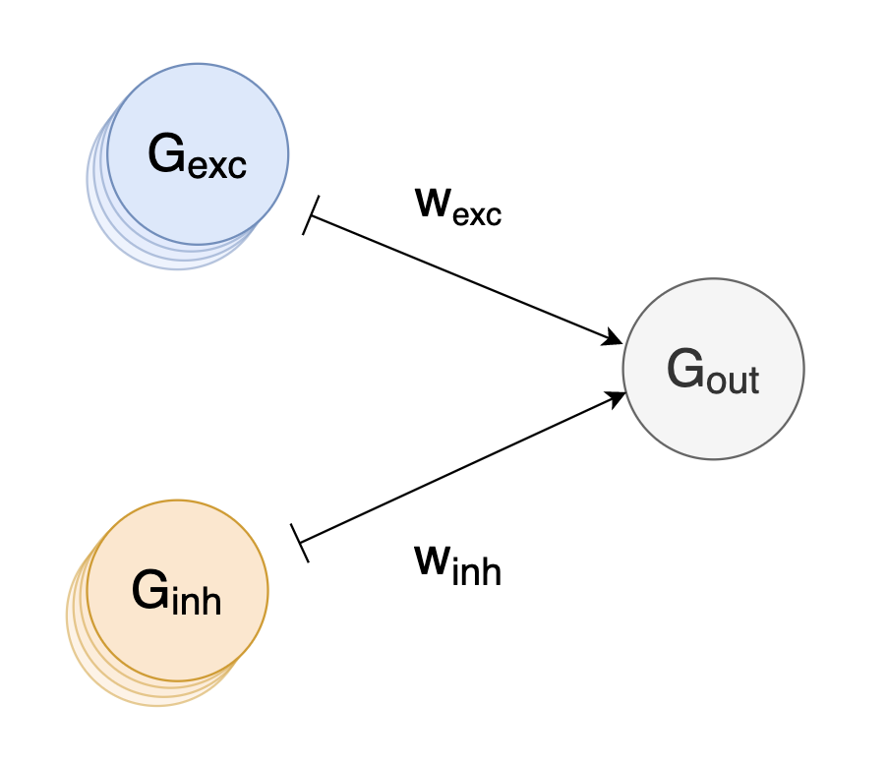
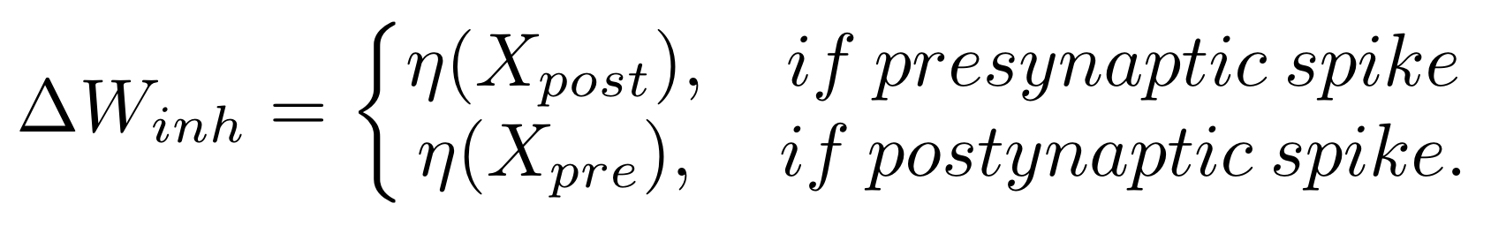
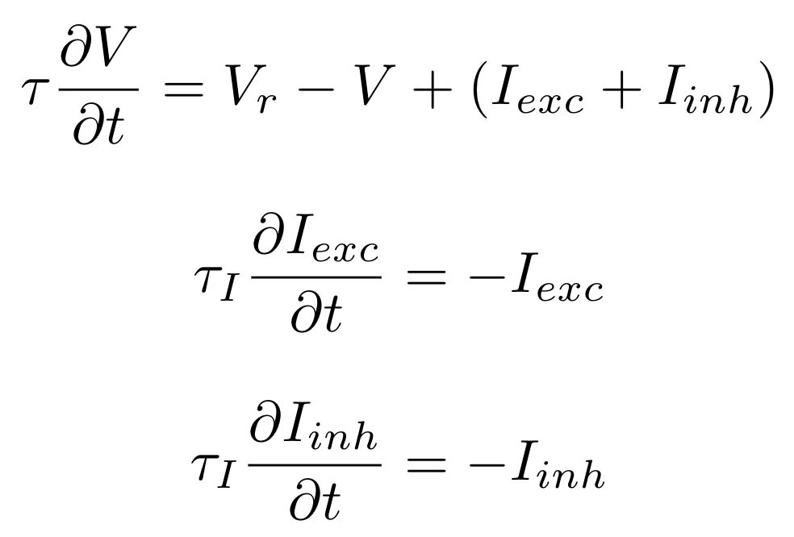
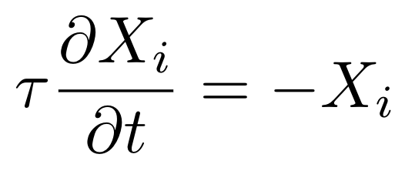
Balance excitation/inhibition
LIF neuron receives excitatory and inhibitory inputs
Excitation received is larger than inhibition
Implement learning rule to balance excitation/inhibition by updating W_{inh}
Dynamics LIF
(“I” increases/decreases with spikes)
(“I” decays over time)
(τ_{I} is much faster than τ)
Learning rule similar to Vogels et al
(Updates at spikes time)
(Traces to track spiking rate)
Vogels, Tim P., et al. "Inhibitory plasticity balances excitation and inhibition in sensory pathways and memory networks." Science 334.6062 (2011): 1569-1573.

Slide 23
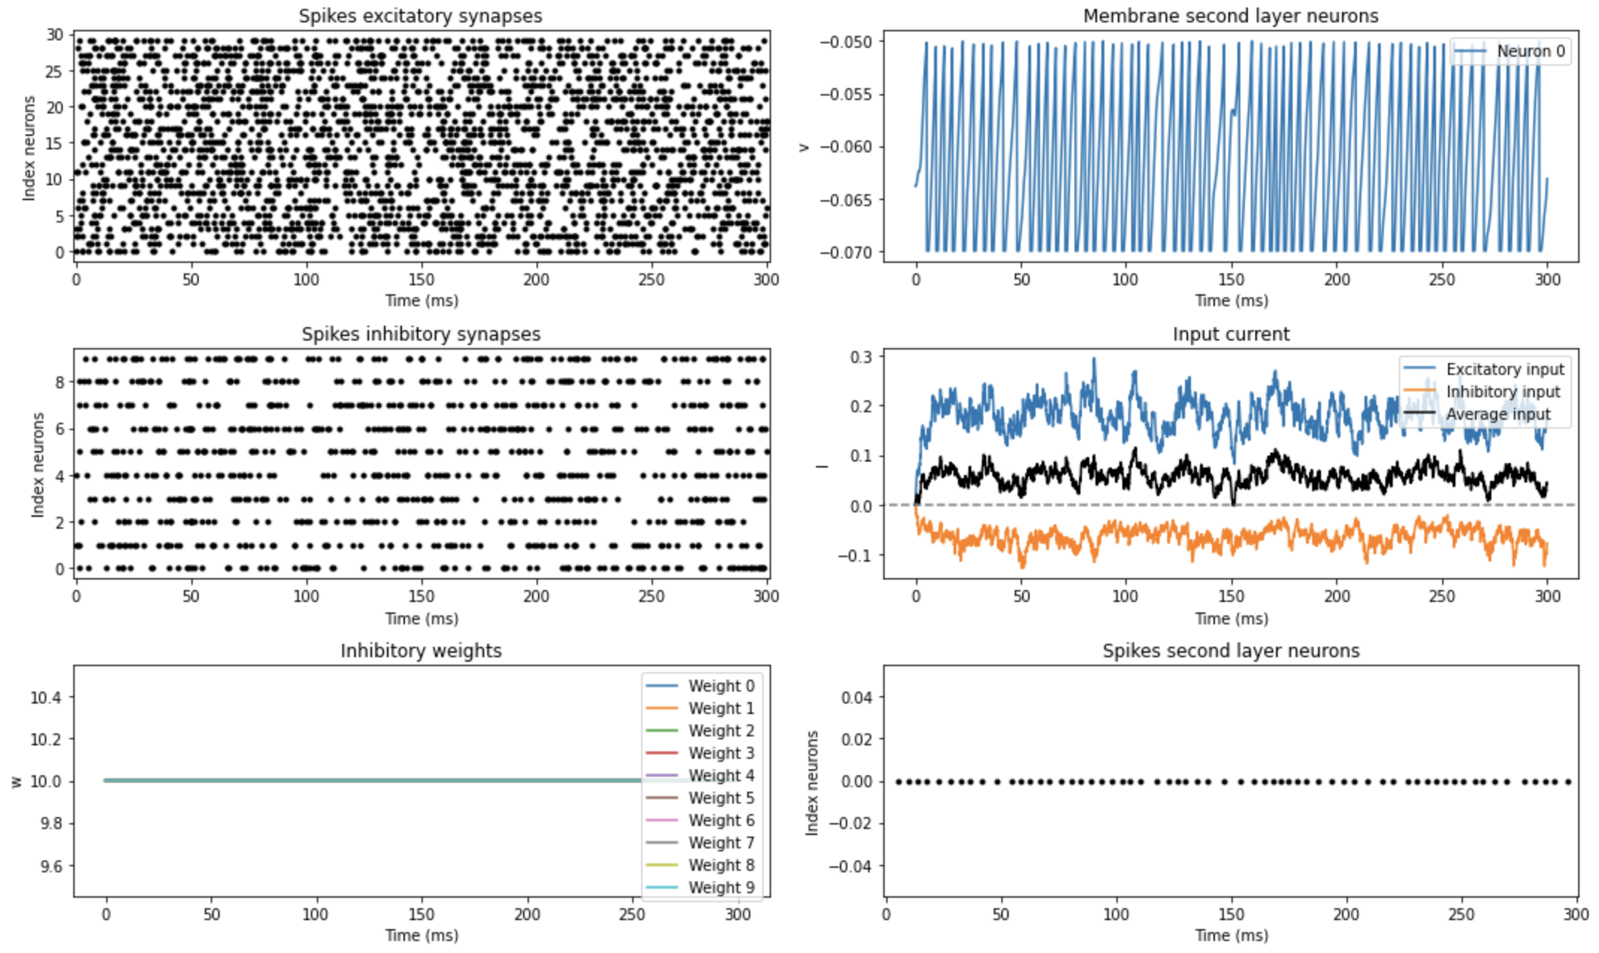
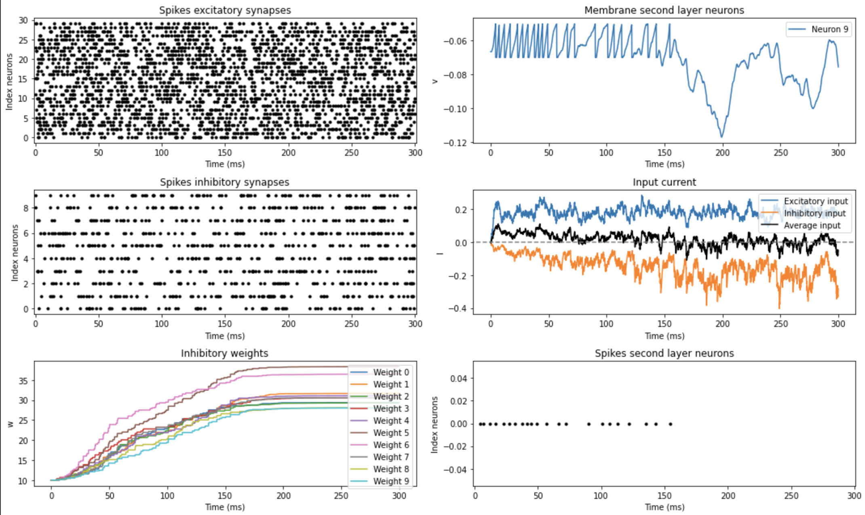
Balance excitation/inhibition
(Poisson input spikes)
No learning
Learned weights

Slide 24
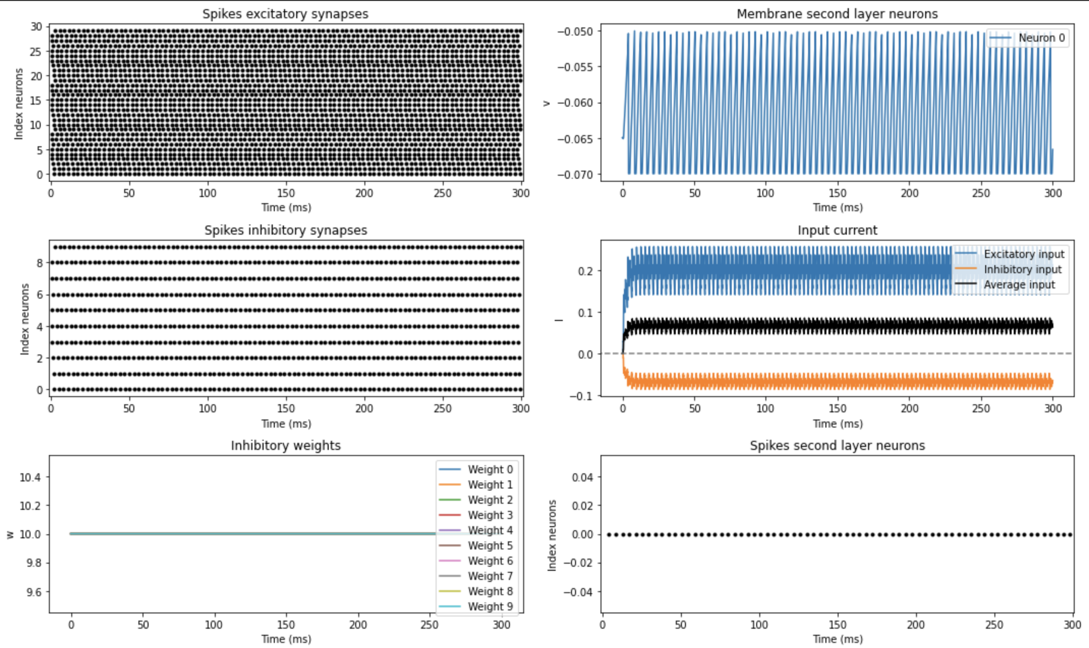
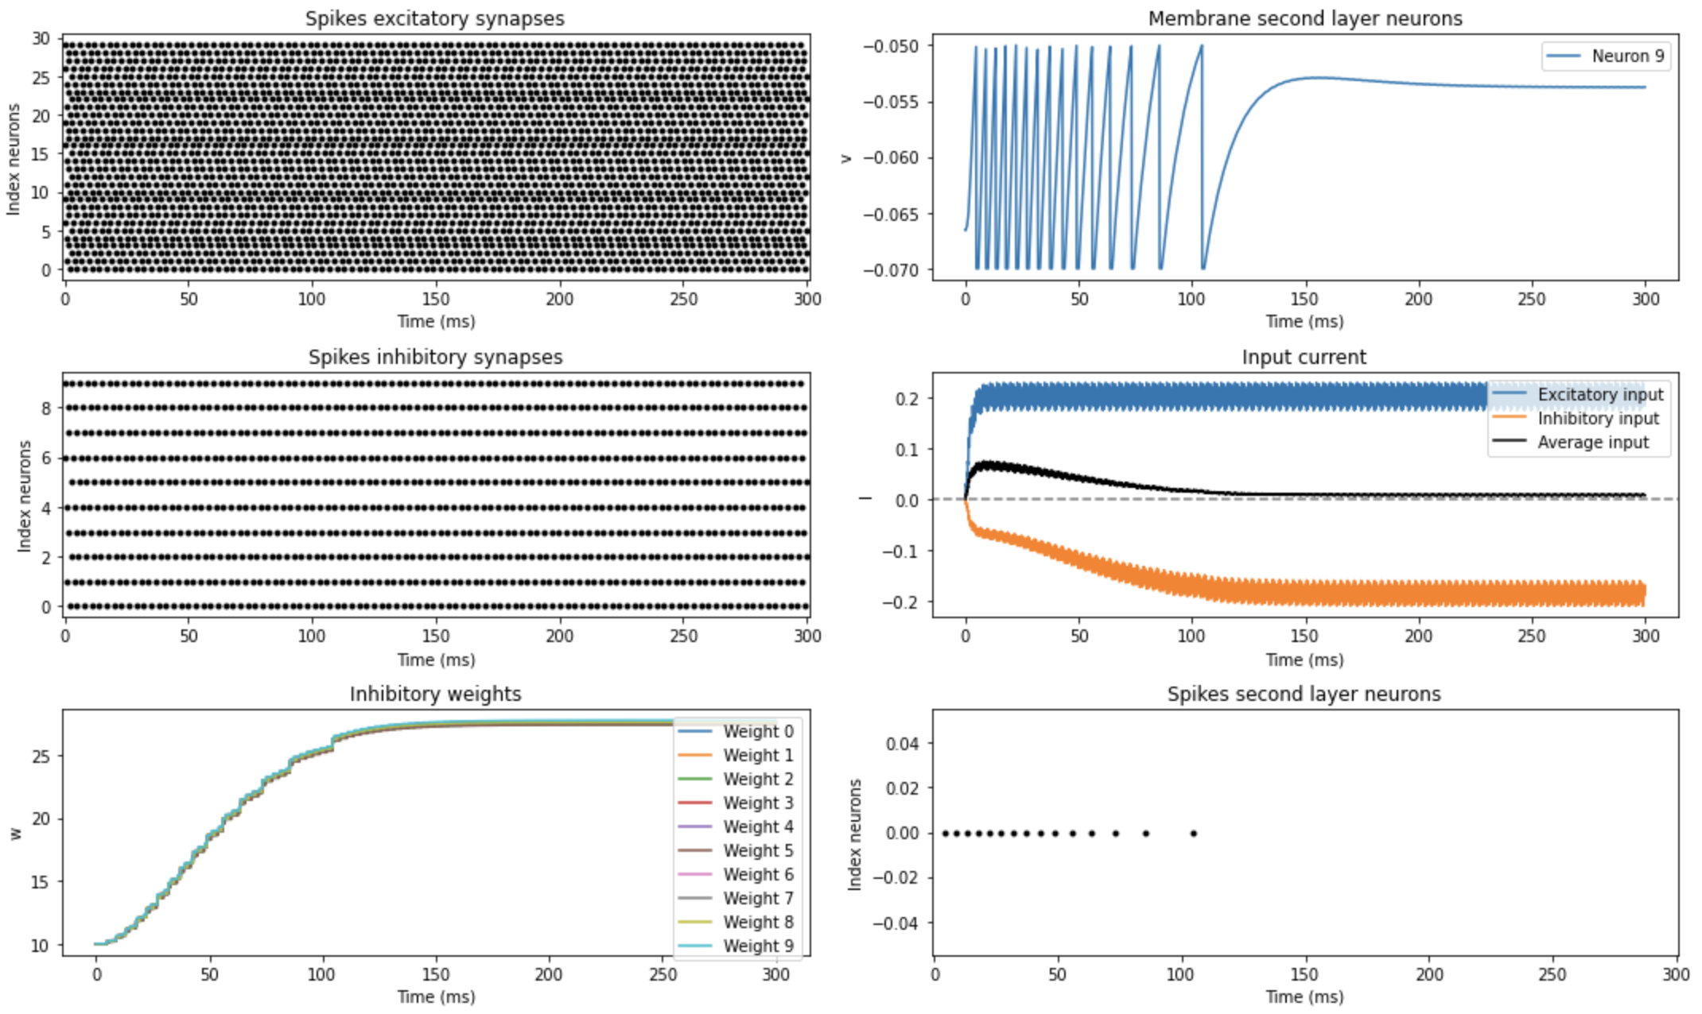
Balance excitation/inhibition
(Uniform input spikes)
No learning
Learned weights

Slide 25
Solved tasks
Link to notebook:
https://colab.research.google.com/drive/1e4vvgqbMEXZmjnvtnkfuQmr4zFZsjzyB?usp=sharing
https://github.com/jesusgf96/Brian2GeNN_introduction/blob/main/Brian2GeNN_solved_tasks.ipynb

Slide 26
Complex models

Slide 27
Example complex synapses
Here I’ll quickly show the network I’m working on
Inhibitory synapses to decorrelate inputs
Feedforward synapses to learn transformations
I’ll give some personal insight and mention a few struggles I found with Brian2GeNN

Slide 28
Not supported features Brian2GeNN
Time Arrays on GPU
Use Run Regularly to call them from CPU
Multiple clocks (Only one run regularly)
Multiple networks
Multiple runs
Restart GeNN backend before every run
Monitoring values is slow (Data is copied to CPU constantly)
There are still some more
but these are the ones everyone
will probably face at
some point
https://brian2genn.readthedocs.io/en/stable/introduction/exclusions.html

Slide 29
Multicompartment neurons
Sander’s part

